Slide 1
Building a model for MNIST dataset using convolutional neural network
BY
R.PUSHPA LATHA
SK.SAIDABI
T.VASAVI
E.DEEPTHI

Slide 2

An Introduction to CNN(Convolutional Neural Network)
We are capable of using many different layers in a convolutional neural
network. However, convolution, pooling, and fully connect layers are the most important ones.

Slide 3
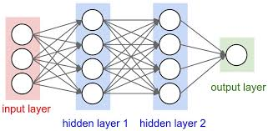
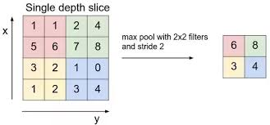

Slide 4
Problem Statement
For humans, identifying numbers in a picture is extremely simple, but how do you train the machine to recognize digits in images ? Convolutional Neural Networks (CNN) can solve this problem.
In this a Convolutional neural network has been trained by identifying digits in MNIST handwritten digital database to predict exactly what the numbers in the picture are.
Obviously, human beings can perceive that there is a hierarchy or conceptual structure in the image, but the machine does not, for example the trained neural network is inconvenient to deal with special changes in a position of numbers in digital pictures.
Exactly put, no matter what the environment of the image (image background) is, it is unchallenging for human beings to judge whether there is such a figure in the image and it is unnecessary to repeat the learning training.

Slide 5

Dataset

Slide 6
Steps in the Program
Import the libraries and datasets
Split the dataset into train and test sets
Create the model
Compile the model
Train the model
Predict the output

Slide 7
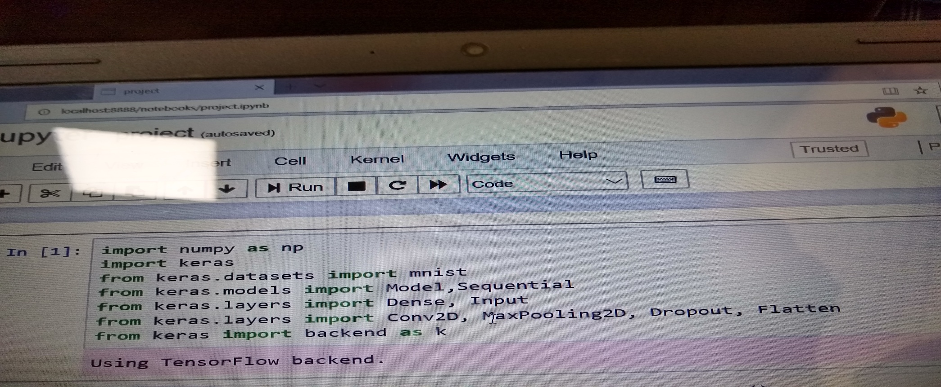
Import the libraries and datasets
NUMPY : Numpy provides a high-performance multidimentional array and basic tools to compute with and manipulate these array.

Slide 8
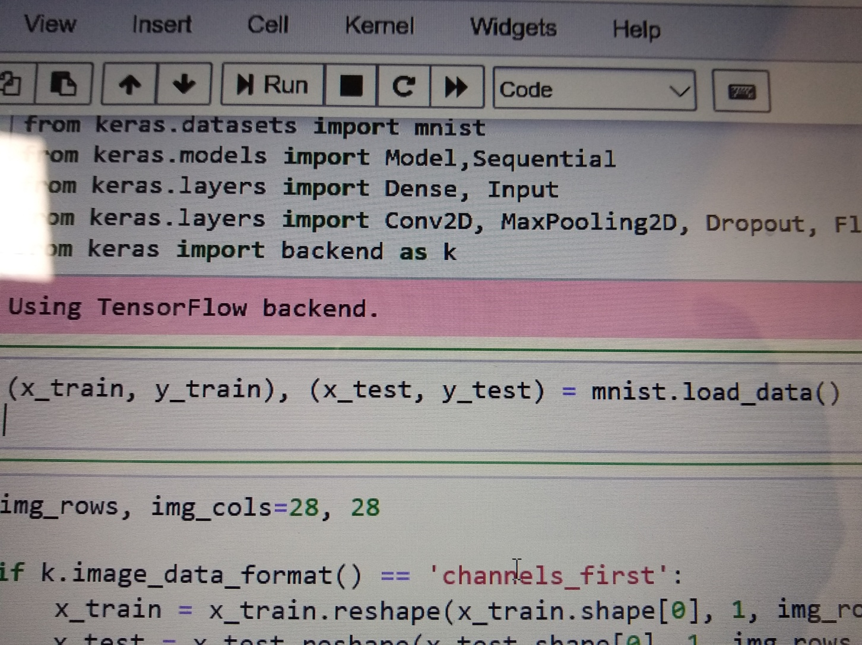
Split the dataset into train and test

Slide 9
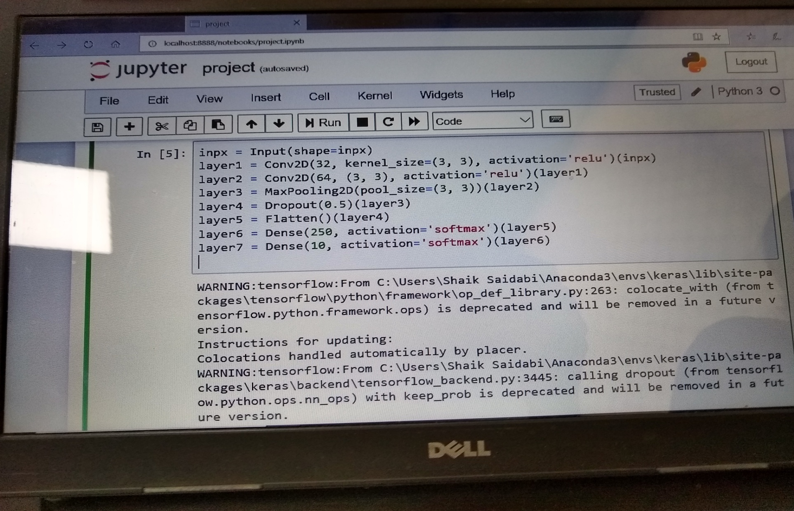
Create the model

Slide 10
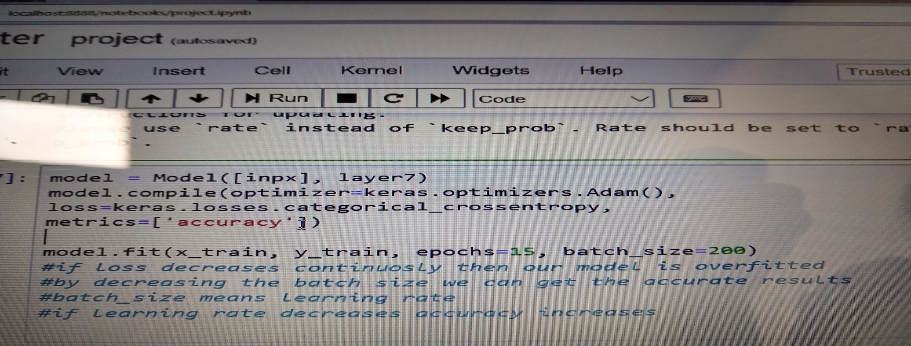
Model Compilation
once the model is defined it is need to be compiled this creates the efficient structures used by the underlying backend in order to efficient execute the model during training.

Slide 11
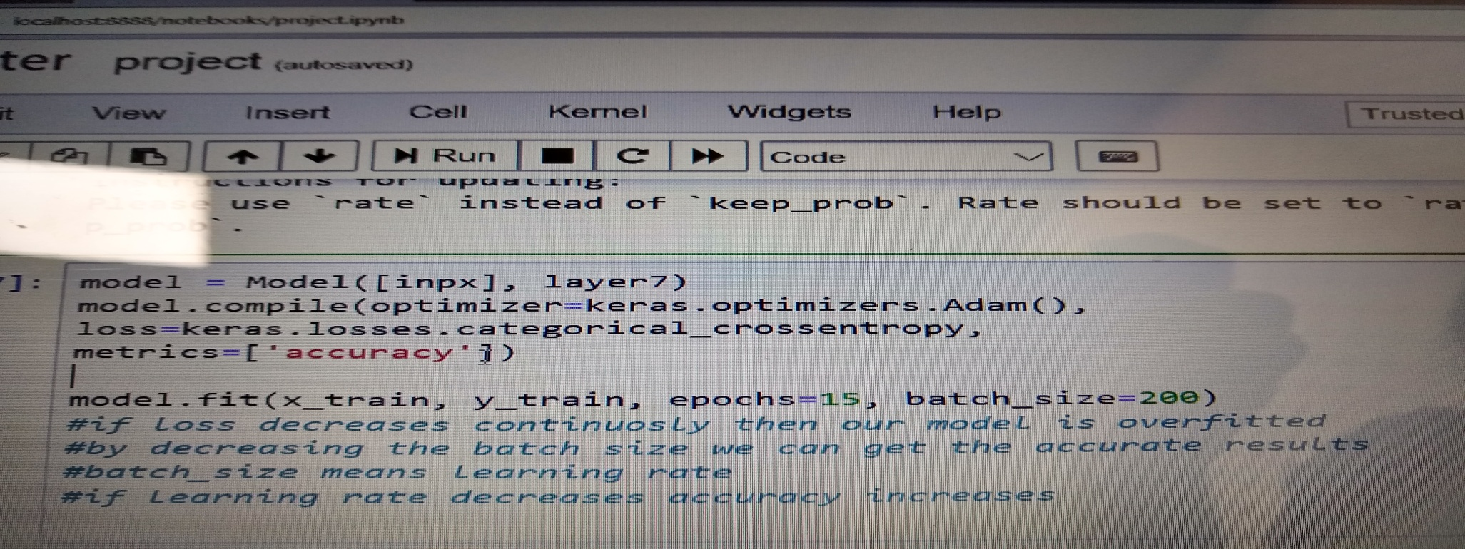
Train the model
The model is trained on Numpy array using the fit() function
It has two specification 1)number of epochs 2)batch size
Epochs is the number of times that the model is exposed to the training dataset
Batch size is the number of training instances shown to the model before a weight update is performed

Slide 12
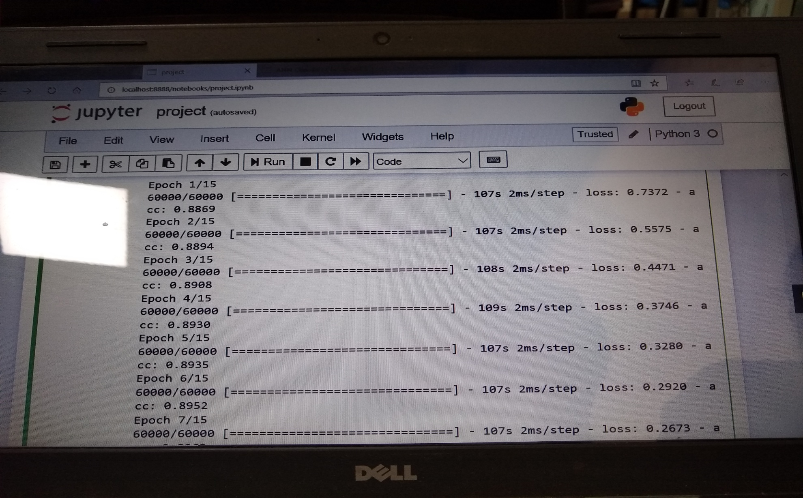

Slide 13
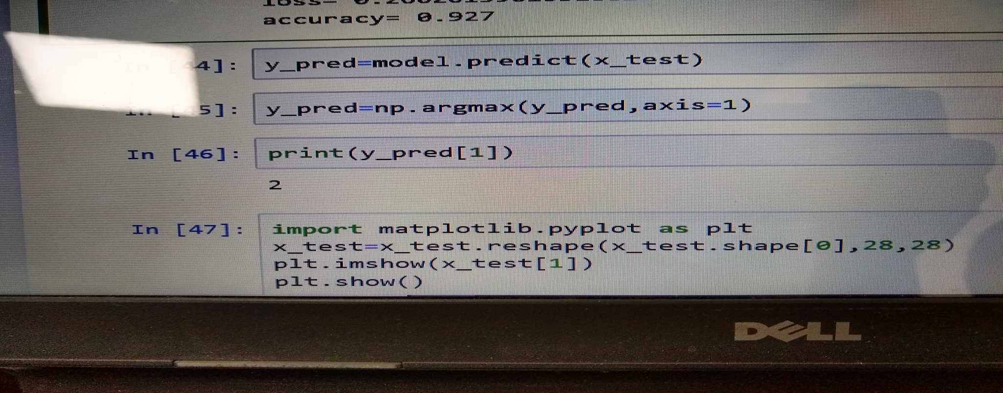
Model Prediction
we can use model to make prediction on test data or new data
model. Predict():- is method used generate network output for input data.

Slide 14
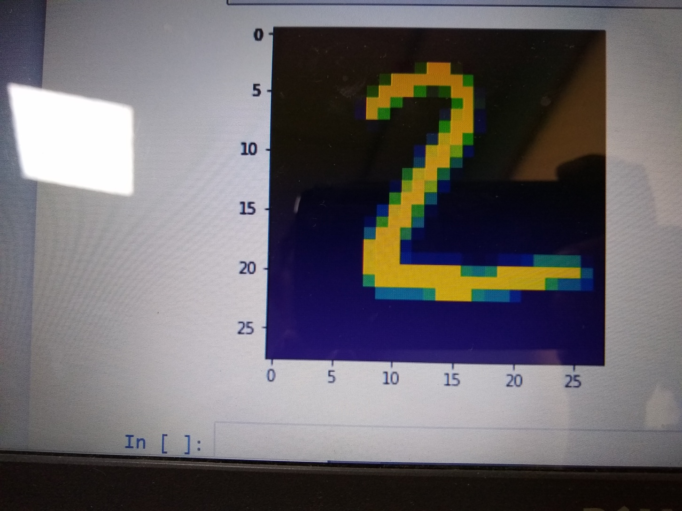

Slide 15
Conclusion
We get more accuracy with this Convolutional Neural Network compared to Artificial Neural Network.
The accuracy is 0.9847

